Slide 1




Sanu K Joseph
Generative AI
Generative AI is still in its early stages, and we have only scratched the surface of what it can do

Slide 2



Sanu K Joseph
About Gen AI
Generative AI creates diverse content like text and images. Its advancements since the 1960s, particularly with GANs in 2014, enable realistic content creation. Innovations like transformers and LLMs enhance its capabilities, despite early accuracy issues. Generative AI promises to revolutionize enterprise technology, from coding to supply chains

Slide 3

Sanu K Joseph
How does Generative
AI work?
Generative AI works by taking a prompt, like text or an image, and generating new content based on it. Early versions required complex processes, but now, there are user-friendly interfaces where you can describe your request in plain language and customize the results.

Slide 4




Sanu K Joseph
Generative AI Model Overview:
Generative AI uses algorithms to process content, potentially inheriting biases from training data.
Neural Networks in Generative AI:
Neural networks learn from data, evolving with computational power and big data to generate content.
Dall-E, ChatGPT, and Gemini:
Dall-E connects words with visuals, ChatGPT simulates conversations, and Gemini evolves with Google's data for better responses.

Slide 5
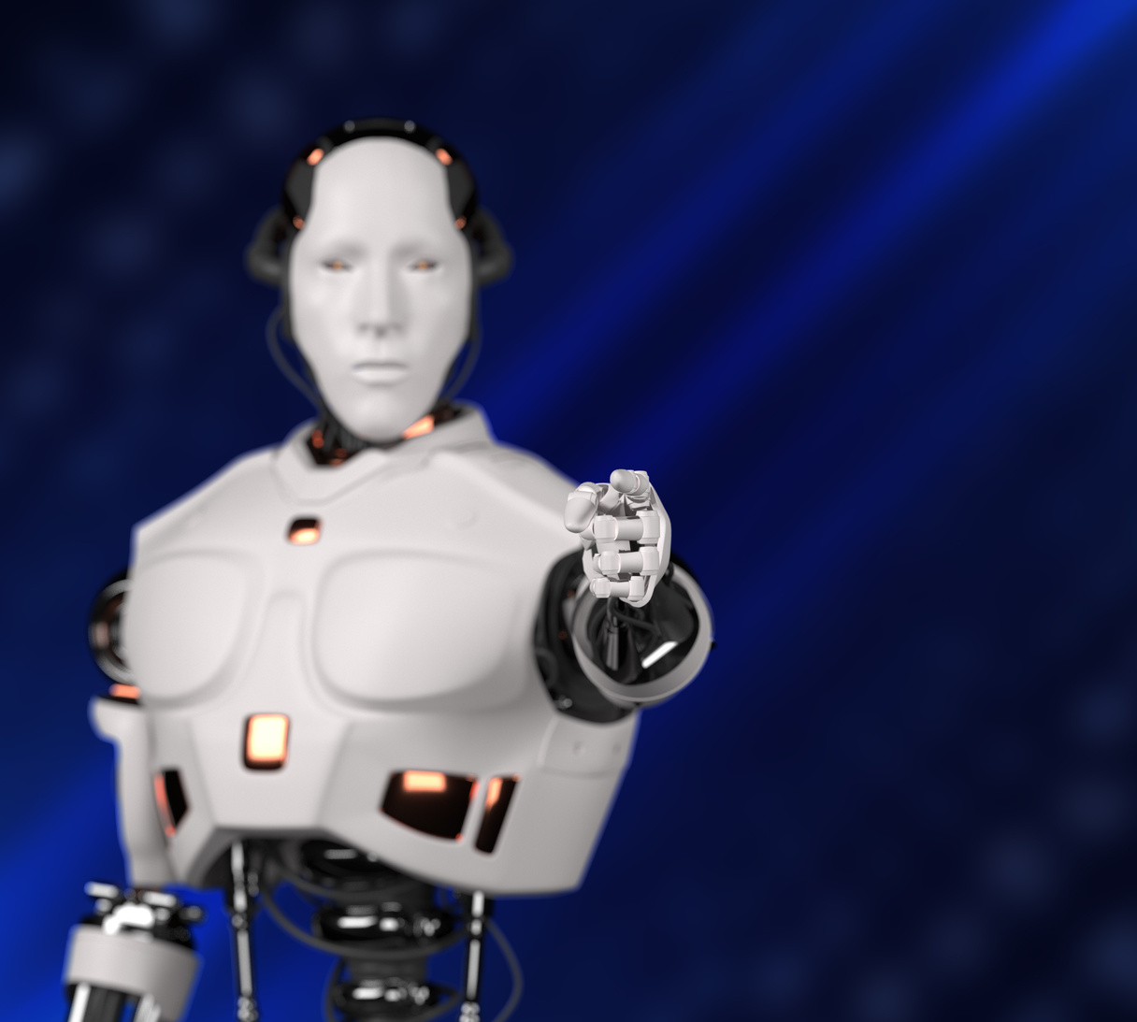


Sanu K Joseph
Use Case
Generative AI creates diverse content, advancing with user-friendly interfaces and key innovations like GANs and transformers.
Customer service chatbots
Deepfakes
Multilingual dubbing
Content creation, design, and drug discovery

Slide 6
Sanu K Joseph
Limitations
Early implementations highlight several challenges:
Difficulty in identifying content sources.
Assessing bias in original sources is challenging.
Realistic content complicates spotting inaccuracies.
Adapting for new situations can be complex.
Biases and prejudices may not be adequately addressed in results.
04

Slide 7


Sanu K Joseph
Concerns
The rise of generative AI raises quality, misuse, and business disruption concerns. Issues include:
Producing inaccurate information.
Trust challenges without clear content sources.
Facilitating new forms of plagiarism.
Disrupting established business models.
Enabling the creation of fake news.
Undermining the credibility of photographic evidence.
Facilitating impersonation for cyber attacks.

Slide 8

Sanu K Joseph
Thank
You.

